Slide 1
HTML Basics
Chapter-2

Slide 2
What is HTML?
HTML (HyperText Markup Language) is a set of markup symbols or codes placed in a file for display on a web page.
It identifies structural elements like paragraphs, headings and lists.
HTML allows media such as graphics, videos and audio to be displayed.
Browsers interpret the markup code and render the page for platform-independent display.

Slide 3
Example HTML5 Web Page
A basic HTML5 web page template is as follows:
<!DOCTYPE html>
<html lang="en">
  <head>
  <title>Page Title Goes Here</title>
  <meta charset="utf-8">
  </head>
  <body>
    ... body text and more HTML tags go here ...
    </body>
</html>

Slide 4
HTML Elements
The <html> element indicates that the document is HTML formatted and tells the browser how to interpret it.
Placement:
The opening tag <html> is placed right below the doc type declaration.
The closing tag </html> is placed at the end of the document, after all other HTML elements.
Language Attribute (lang)
The<html>element should specify the spoken language of the document.
This is done using the lang attribute.
<html lang="en">
“en” indicates English.

Slide 5
Head, Title, Meta, and Body Elements
Two sections on a web page:
Head section ( header section)
- The head section contains information that describes the web page document
Body section
- The body section contains the actual tags, text, images and other objects that are displayed by the browser as a web page

Slide 6
Head Section
The <head> element contains important meta information about the webpage.
It begins with <head> and ends with </head>.
Common elements in the <head> section:
◦<title>element
◦<meta>element

Slide 7
The <title> Element
Configures the text that appears in the browser’s title bar.
The text between <title> and </title> is used for:
◦Bookmark sand printed pages.
◦Search engine optimization (SEO) to determine key word relevance.
◦Displaying titles on search engine results pages.
  <title> My Website-Home </title>
8

Slide 8
The <meta> Element
Provides characteristics of a webpage, such as character encoding.
Character encoding define show letters, numbers and symbols are stored and transmitted.
UTF-8 is the most common character encoding, as it supports a wide range of characters (Unicode).
The<meta> tag is a self-contained or void element in HTML5.
<meta charset="utf-8">

Slide 9
The Body Section
Displays content directly in the browser viewport.
Configures the webpage’s visible content.
Begins with <body> and ends with </body>.
Most web page code is written within this section. Includes text, images, video sand interactive elements.

Slide 10
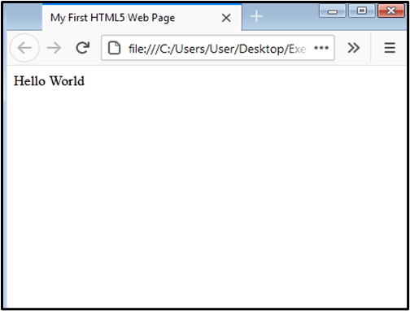
Sample HTML
In the following code is the first HTML5 web page
<!DOCTYPE html>
<html lang="en">
  <head>
  <title> My First HTML5 Web Page </title>
  <meta charset="utf-8">
    </head>
  <body>
  Hello World!
    </body>
</html>
Figure 1 : Hello World web page

Slide 11
HTML Heading Elements
Organized into six levels: <h1> to <h6>.
Rendered as a block of text with white space above and below.
Text size:
◦<h1>: Largest
◦<h6>: Smallest
◦<h4>, <h5>, <h6> may be smaller than default text size.
Font style: Bold for all heading levels.
Used to structure and emphasize content on a web page.
Attribute –align (right/ left(default) / center / justify)
<body>
<h1 align=“center"> ………. </h1>
</body>

Slide 12
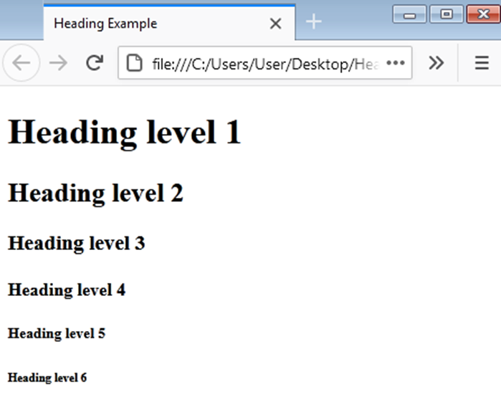
Sample Code
<!DOCTYPE html>
<html lang="en">
<head>
<title>Heading Example</title>
<meta charset="utf-8">
</head>
<body>
<h1>Heading Level 1</h1>
<h2>Heading Level 2</h2>
<h3>Heading Level 3</h3>
<h4>Heading Level 4</h4>
<h5>Heading Level 5</h5>
<h6>Heading Level 6</h6>
</body>
</html
Figure 2: Web Page document with six levels headings

Slide 13
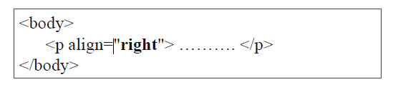
HTML Paragraph Elements
Used to group sentences and sections of text.
Enclosed by <p> and </p> tags.
Displayed as a block with white space above and below.
Attribute : align (right/left(default)/center/justify)

Slide 14
HTML Paragraph Elements
<!DOCTYPE html>
<html lang="en">
<head>
<title>Paragraph Example</title>
<meta charset="utf-8">
</head>
<body>
<h1>Heading Level 1</h1>
  <p>This is a sample paragraph.<br> Heading tags can help to make your pages more accessible and usable. It is good coding practice to use heading tags to outline the structure of your web page content.</p>
  <h2>Heading level 2</h2>
  <h3>Heading level 3</h3>
  <h4>Heading level 4</h4>
  <h5>Heading level 5</h5>
  <h6>Heading level 6</h6>
</body>
</html>

Slide 15
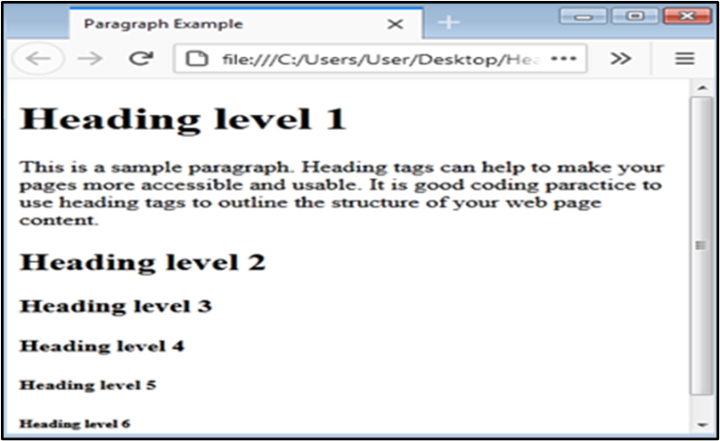
Output…
Figure 3: Web Page document with a paragraph

Slide 16
Line Break Element (<br>)
Advances text to the next line on a webpage.
Tag Format: <br> (void element, no closing tag).
Used to create line breaks without starting a new paragraph.
Enhances text formatting and read ability.

Slide 17
Sample Code
<!DOCTYPE html>
<html lang="en">
  <head>
  <title>Line Break Example</title>
  <meta charset="utf-8">
  </head>
  <body>
  <h1>Heading Level 1</h1>
  <p>This is a sample paragraph. <br> Heading tags can help to make your pages more accessible and usable. </p>
  </body>
  </html>

Slide 18
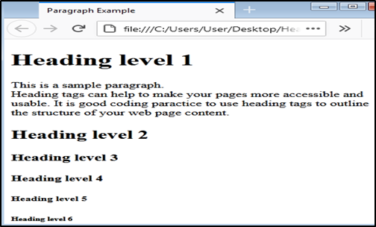
Output…
Figure 4: The line break after the first sentence

Slide 19
Blockquote Element
Used to display a block of quoted text.
Formatting: Indented from both left and right margins.
Syntax:
◦ Begins with <blockquote>
◦ Ends with</blockquote>
Enhances read ability and highlights quotations on webpages.

Slide 20
Sample Code
<!DOCTYPE html>
<html lang="en">
    <head>
  <title>Block quote Example </title>
  <meta charset="utf-8">
  </head>
  <body>
  <h1>The Power of the Web </h1>
  <p>According to Tim Berners - Lee, the inventor of the World Wide Web,
  at http://www.w3.org/WAI/:</p>
  <blockquote>
The power of the Web is in its universality. Access by everyone regardless of disability is an essential aspect.
  </blockquote>
  </body>
</html

Slide 21
Phrase Elements
Indicate the context and meaning of text between the container tags.
Inline with surrounding text (inline display).
Can be used for a section of text or even a single character.

Slide 22
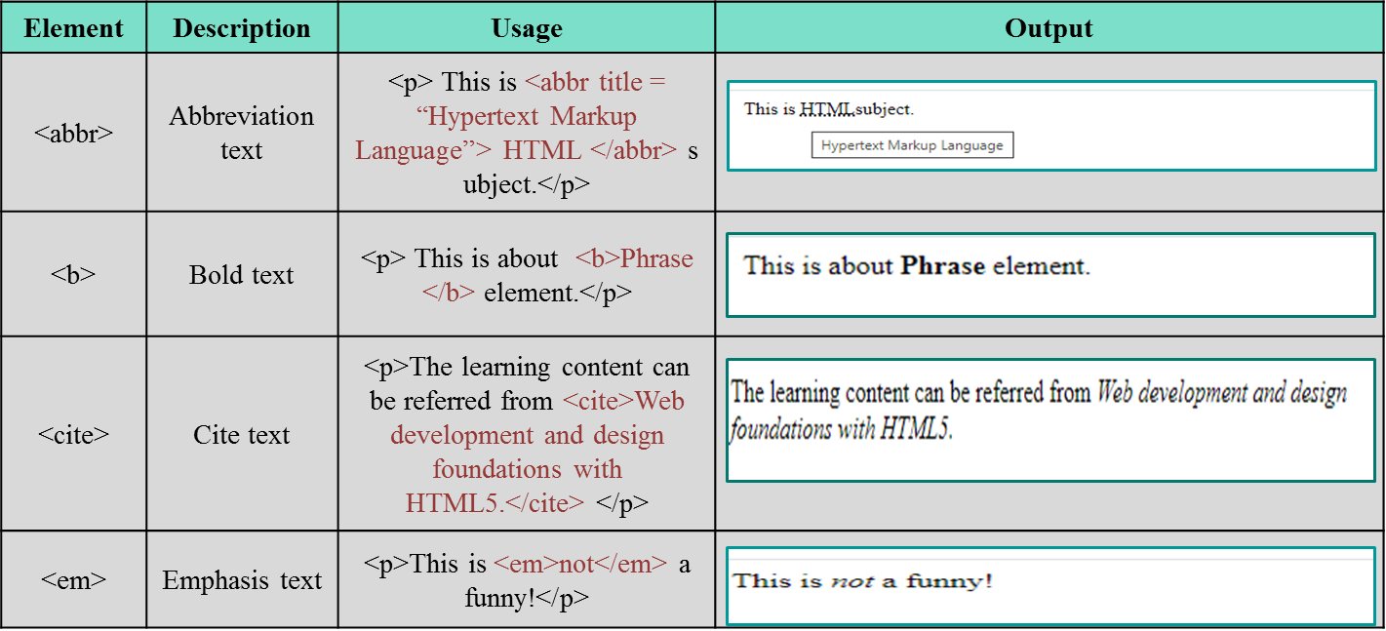
Table 1: Lists of Phrase Elements

Slide 23
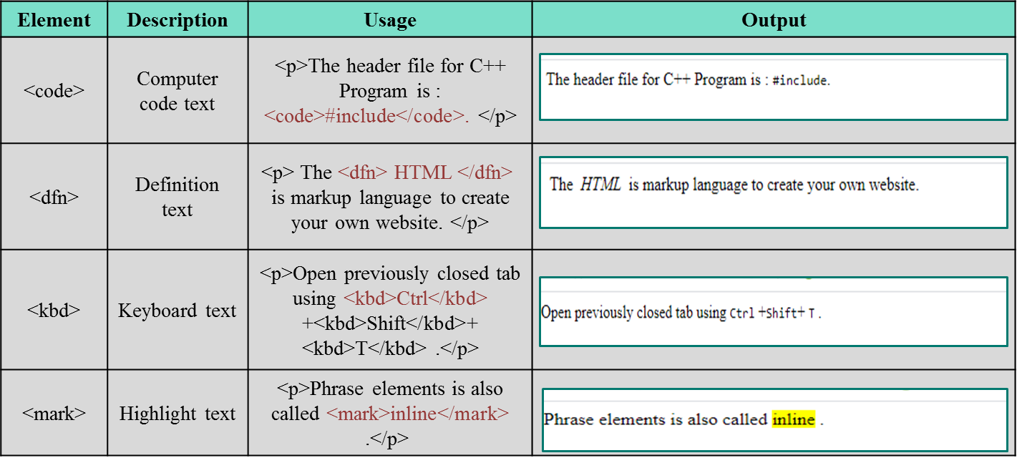
Table 2: Lists of Phrase Elements

Slide 24
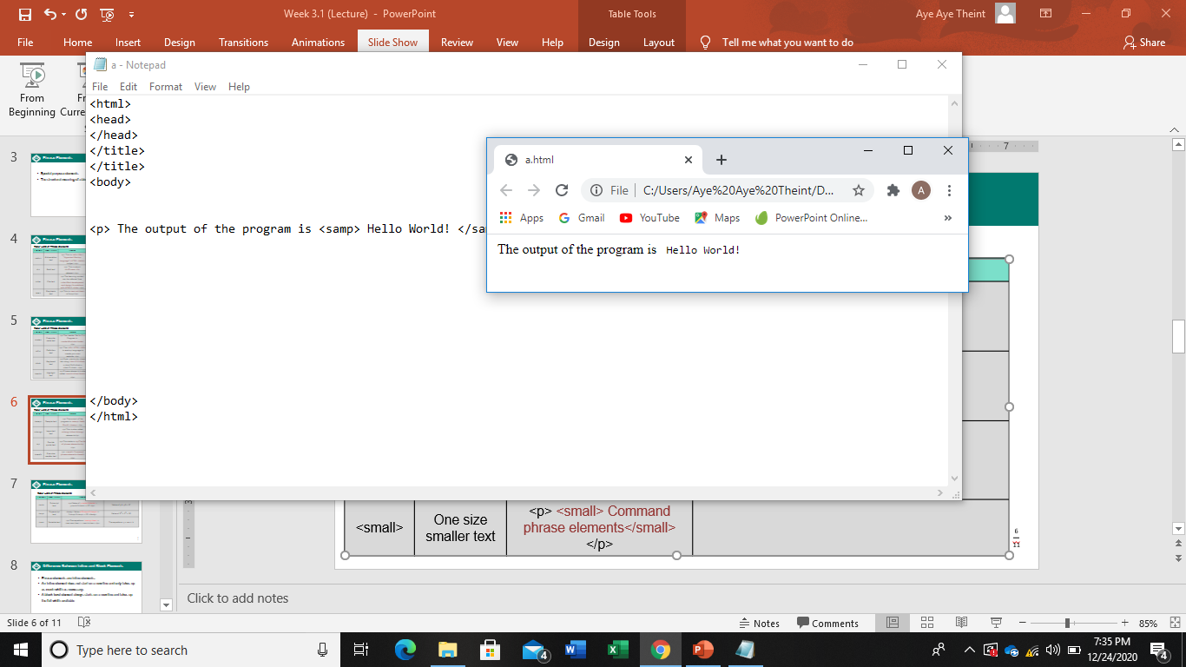
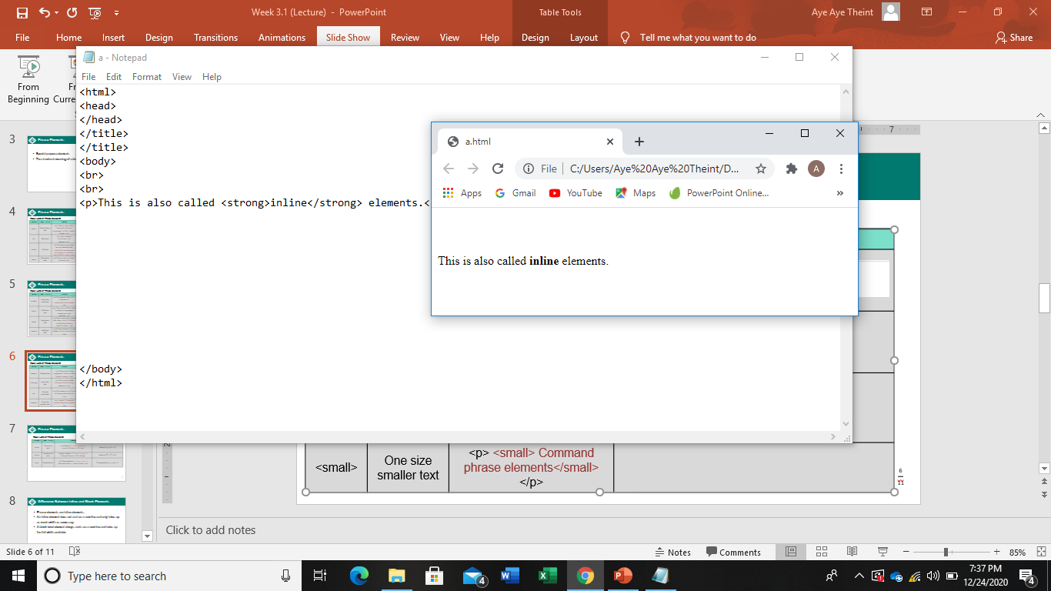
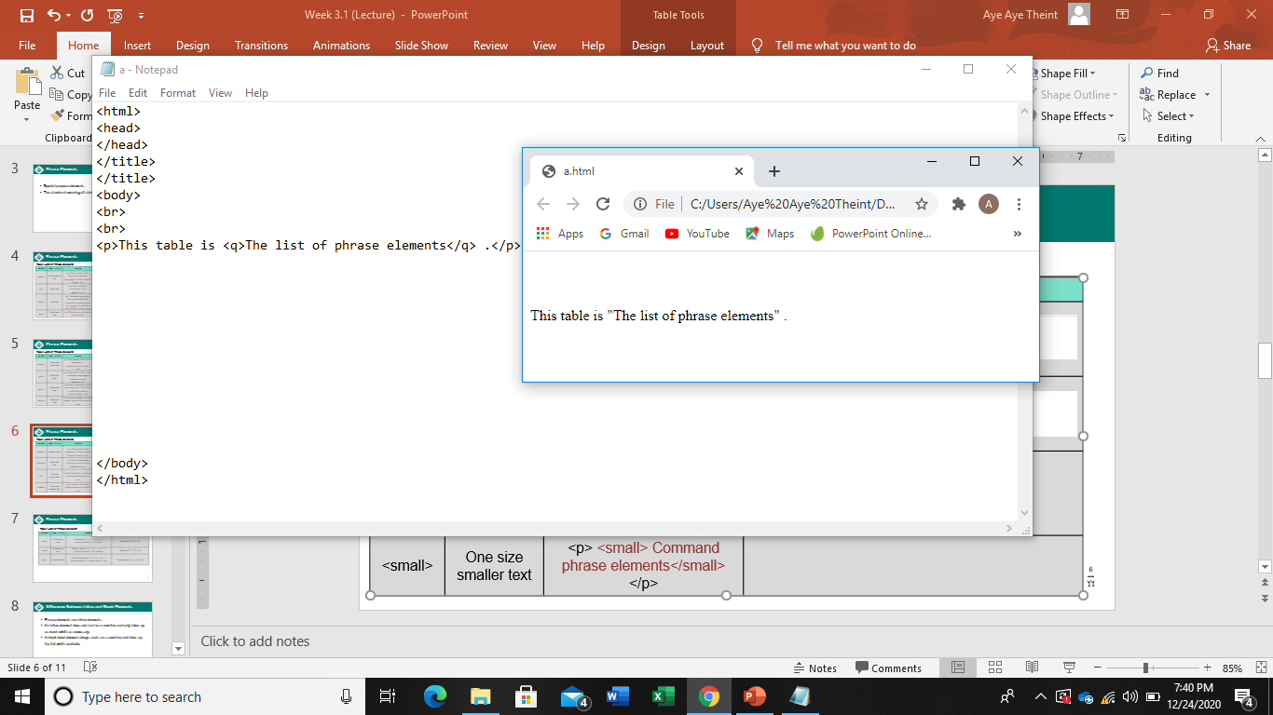
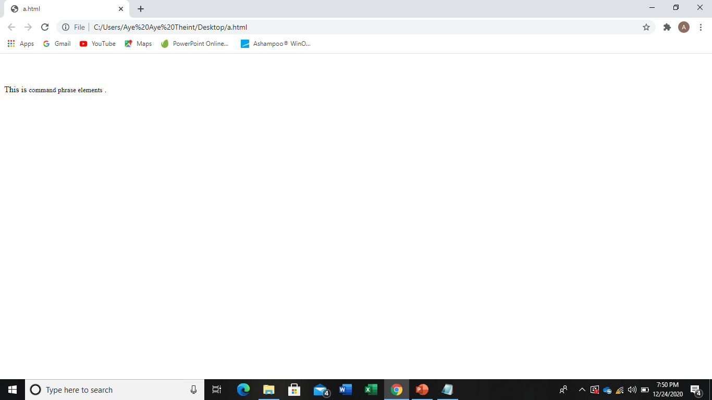
Table 3: Lists of Phrase Elements
Element | Description | Usage | Output
<samp> | Sample text | <p> The output of the program is <samp> Hello World! </samp> </p>
<strong> | Important text | <p>This is also called <strong>inline</strong> elements.</p>
<q> | Double quote text | <p>This table is <q>The list of phrase elements</q> .</p>
<small> | One size smaller text | <p> This is <small> command phrase elements</small> .</p>

Slide 25
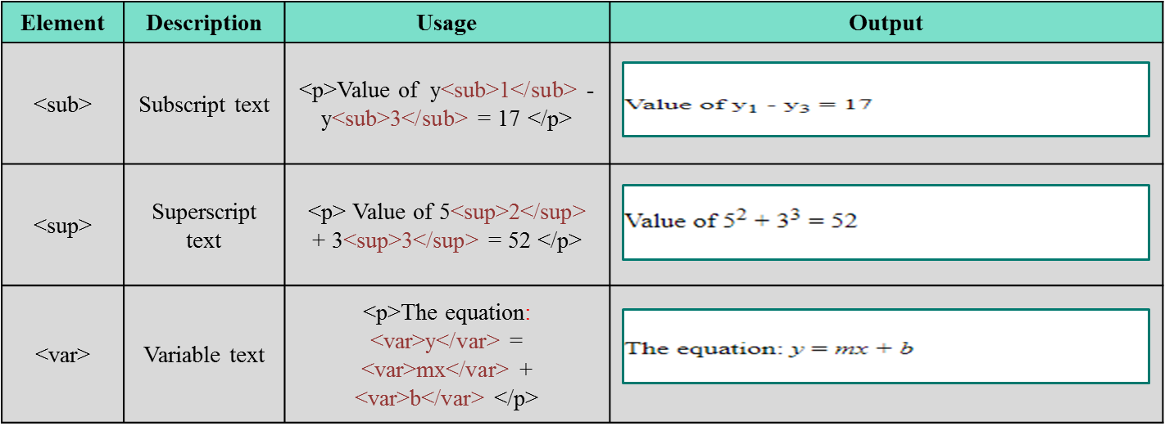
Table 4: Lists of Phrase Elements

Slide 26
Sample Code
<!DOCTYPE html>
<html lang="en">
<head>
<meta charset="UTF-8">
<title>HTML Elements Example</title>
</head>
<body>
<h1>HTML Elements Example</h1>
<p><abbr title="Hypertext Markup Language">HTML</abbr> is a <b>markup</b> language.</p>
<p><strong>This text is strong</strong> and <em>this text is emphasized</em>.</p>
<p><i>This is italicized text</i> and <mark>this is highlighted</mark>.</p>
<p><small>This is small text</small> and <big>This is big text</big>.</p>
<p><sup>This is superscript</sup> and <sub>This is subscript</sub>.</p>
</body>
</html>24

Slide 27
Sample Code
<!DOCTYPE html>
<html lang="en">
<head>
<meta charset="UTF-8">
<title>HTML Elements Example</title>
</head>
<body>
<p><cite>Example Source</cite> refers to a source citation.</p>
<p>Use the <code>print()</code> function in Python to display output.</p>
<p><dfn>HTML</dfn> stands for Hypertext Markup Language.</p>
<p><kbd>Ctrl + C</kbd> is used to copy text.</p>
<p><samp>Output: Success</samp> is an example of a system message.</p>
<p>The <var>x</var> variable stores the result of the calculation.</p>
</body>
</html>

Slide 28
Ordered List
An ordered list displays a numbering or lettering system to itemize information
The list items are automatically numbered or lettered based on the chosen format
Ordered lists begin with an <ol> tag and end with an </ol> tag
Each list item begins with an < tag and ends with an </ tag>
Types of Ordered Lists
Numerals ( Items are numbered using standard numerals 1 2 3
Uppercase Letters Use type="A“
Lowercase Letters Use type="a"
Uppercase Roman Numerals Use type="I"
Lowercase Roman Numerals Use type=" i"

Slide 29
Sample Code
<!DOCTYPE html>
<html lang="en">
<head>
<meta charset="UTF-8">
<title>Ordered List Example</title>
</head>
<body>
<h3> To Learn Basic Web Design</h3>
<ol type="1">
<li>Learn the basics of HTML</li>
<li>Understand CSS for styling</li>
<li>Get familiar with responsive design principles</li>
</ol>
</body>
</html>

Slide 30
Ordered List Attributes in HTML5
start attribute
allows you to specify the starting number for an ordered list
By default, the list starts at 1 but you can change it to any integer
reversed attribute
configures the list markers to display in descending order
When applied, the numbering starts from the highest number and decreases
<ol start="5" reversed="reversed">
<li>Item 5</li>
<li>Item 4</li>
<li>Item 3</li>
</ol>

Slide 31
Unordered List
An unordered list displays a bullet or list marker before each list entry
Unordered lists begin with an <ul> tag and end with an </ul> tag
Each list item begins with an <li> tag and ends with an </li> tag
Types of Unordered Lists:
  Disc (default)
  Square use type=“square”
  Circle use type=“circle”

Slide 32
Sample Code
<!DOCTYPE html>
<html lang="en">
<head>
<title> Heading and List</title>
<meta charset="utf-8">
</head>
<body>
<h1> Popular Web Server</h1>
<ul>
<li> Apache Web server</li>
<li> Microsoft IIS</li>
<li> Oracle iPlanetWeb Server</li>
</ul>
</body>
</html>30

Slide 33
Description List
A description list organizes terms and their corresponding descriptions
Begins with the <dl> tag and ends with </dl>
Each term or name is defined with the <dt> tag (Definition Term)
Each description follows with the <dd> tag (Definition Description)

Slide 34
Sample Code
<dl>
<dt>HTML</dt>
<dd>HTML stands for HyperText Markup Language, used to create webpages.</dd>
<dt>CSS</dt>
<dd>CSS stands for Cascading Style Sheets, used to style the layout of webpages.</dd>
<dt>JavaScript</dt>
<dd>JavaScript is a programming language used to create interactive effects with in web browsers.</dd>
</dl>

Slide 35
Special Characters
Double Quotation mark &quot;
Single Quotation mark &rsquo;
Copyright © &copy;
Less than &lt;
Greater than &gt;
Ampersand &amp;
Heart ♥ &hearts;
Blank space &nbsp;
Long dash &mdash;

Slide 36
Sample Code
<!DOCTYPE html>
<html lang="en">
<head>
<meta charset="UTF-8">
<title>Contact Us</title>
</head>
<body>
<h1>Contact Us</h1>
<p>Email: support &nbsp; &commat; &nbsp; abc.com</p>
<p>Business Hours: 9:00AM &ndash; 5:00PM</p>
<p>All rights reserved &copy; 2024 ABC Company</p>
<p>Secure your account with symbols like &lt;, &gt;, and &amp;.</p>
<p>We &hearts; our customers!</p>
</body>
</html>

Slide 37
Next Lecture
Configuring Color and Text with CSS

